Slide 1
Concurrency Control in DBMS

Slide 2
Concurrency Control
Concurrency Control in Database Management System is a procedure of managing simultaneous operations without conflicting with each other. It ensures that Database transactions are performed concurrently and accurately to produce correct results without violating data integrity of the respective Database.
Reasons for using Concurrency control method in DBMS:
To apply Isolation through mutual exclusion between conflicting transactions
To resolve read-write and write-write conflict issues
To preserve database consistency through constantly preserving execution obstructions
The system needs to control the interaction among the concurrent transactions. This control is achieved using concurrent-control schemes.
Concurrency control helps to ensure serializability

Slide 3
Why we need concurrency control
Without Concurrency Control, problems may occur with concurrent transactions:
Lost Update Problem.
Occurs when two transactions update the same data item, but both read the same original value before update (Figure 21.3(a), next slide)
The Temporary Update (or Dirty Read) Problem.
This occurs when one transaction T1 updates a database item X, which is accessed (read) by another transaction T2; then T1 fails for some reason (Figure 21.3(b)); X was (read) by T2 before its value is changed back (rolled back or UNDONE) after T1 fails

Slide 5
Why we need concurrency control (cont.)
The Incorrect Summary Problem .
One transaction is calculating an aggregate summary function on a number of records (for example, sum (total) of all bank account balances) while other transactions are updating some of these records (for example, transferring a large amount between two accounts, see Figure 21.3(c)); the aggregate function may read some values before they are updated and others after they are updated.

Slide 7
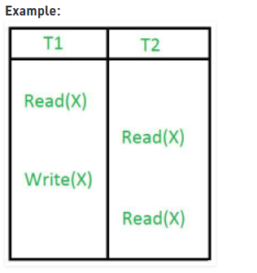
Why we need concurrency control (cont.)
The Unrepeatable Read Problem .
A transaction T1 may read an item (say, available seats on a flight); later, T1 may read the same item again and get a different value because another transaction T2 has updated the item (reserved seats on the flight) between the two reads by T1

Slide 8
Concurrency Control Protocols
Different concurrency control protocols offer different benefits between the amount of concurrency they allow and the amount of overhead that they impose.
Following are the Concurrency Control techniques in DBMS:
Lock-Based Protocols (in Syllabus)
Two Phase Locking Protocol (in syllabus)
Timestamp-Based Protocols (not in Syllabus)
Validation-Based Protocols (not in syllabus)
Graph-based Protocols (not in syllabus)

Slide 9
Lock-based Protocols
Lock Based Protocols in DBMS is a mechanism in which a transaction cannot Read or Write the data until it acquires an appropriate lock.
Lock based protocols help to eliminate the concurrency problem in DBMS for simultaneous transactions by locking or isolating a particular transaction to a single user.
A lock is a data variable which is associated with a data item. This lock signifies that operations that can be performed on the data item.
Locks in DBMS help synchronize access to the database items by concurrent transactions.
All lock requests are made to the concurrency-control manager. Transactions proceed only once the lock request is granted.

Slide 10
TYPES OF LOCKS
Binary Locks: A Binary lock on a data item can either locked or unlocked states.
Shared/exclusive: This type of locking mechanism separates the locks in DBMS based on their uses. If a lock is acquired on a data item to perform a write operation, it is called an exclusive lock.

Slide 11
TYPES OF LOCKS cont…
1.Shared Lock (S):
A shared lock is also called a Read-only lock. With the shared lock, the data item can be shared between transactions. This is because you will never have permission to update data on the data item.
For example, consider a case where two transactions are reading the account balance of a person. The database will let them read by placing a shared lock. However, if another transaction wants to update that account’s balance, shared lock prevent it until the reading process is over.

Slide 12
TYPES OF LOCKS cont…
2. Exclusive Lock (X):
With the Exclusive Lock, a data item can be read as well as written. This is exclusive and can’t be held concurrently on the same data item. X-lock is requested using lock-x instruction. Transactions may unlock the data item after finishing the ‘write’ operation.
For example, when a transaction needs to update the account balance of a person. You can allows this transaction by placing X lock on it. Therefore, when the second transaction wants to read or write, exclusive lock prevent this operation.

Slide 13
TYPES OF LOCKS cont…
T1 |  | T2
S(A) R(A) U(A) |  | X(A) R(A) W(A) U(A)

Slide 14
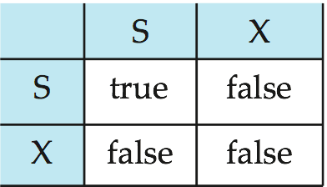
Lock-Based Protocols (Cont.)
Lock-compatibility matrix
A transaction may be granted a lock on an item if the requested lock is compatible with locks already held on the item by other transactions
Any number of transactions can hold shared locks on an item,
but if any transaction holds an exclusive lock on the item no other transaction may hold any lock on the item.
If a lock cannot be granted, the requesting transaction is made to wait till all incompatible locks held by other transactions have been released. The lock is then granted.

Slide 15
Lock-Based Protocols (Cont.)
Example of a transaction performing locking:
T₂: lock-S(A);
read (A);
unlock(A);
lock-S(B);
read (B);
unlock(B);
display(A+B)
A locking protocol is a set of rules followed by all transactions while requesting and releasing locks. Locking protocols restrict the set of possible schedules.

Slide 16
Pitfalls of Lock-Based Protocols
May not free from Irrecoverability
May not free from deadlock
May not free from Starvation

Slide 17
Pitfalls of Lock-Based Protocols(May not free from Irrecoverability )
T1 T2
X(A)
R(A)
W(A)
U(A)
^{S(A)}
R(A) Dirty read problem
^{U(A)}
^{commit}
^{Abort}

Slide 18
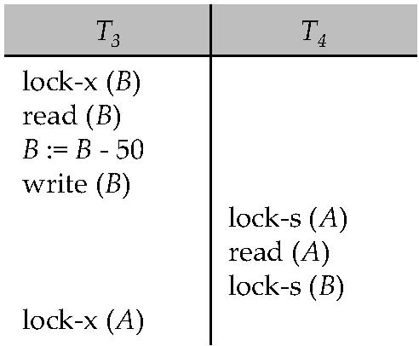
Pitfalls of Lock-Based Protocols(Deadlock)
Neither T₃ nor T₄ can make progress — executing lock-S(B) causes T₄ to wait for T₃ to release its lock on B, while executing lock-X(A) causes T₃ to wait for T₄ to release its lock on A. Such a situation is called a deadlock.
To handle a deadlock one of T₃ or T₄ must be rolled back and its locks released.

Slide 19
Pitfalls of Lock-Based Protocols(Deadlock)
Consider the partial schedule
T1 T2
^{Grant X(A)}
^{X(B) Grant Lock}
^{Wait X(B)}
^{X(A) (Wait)}
Deadlock
Deadlock refers to a specific situation where two or more processes are waiting for each other to release a resource or more than two processes are waiting for the resource in a circular chain.

Slide 20
Pitfalls of Lock-Based Protocols (Cont.)
The potential for deadlock exists in most locking protocols. Deadlocks are a necessary evil.
Starvation is also possible if concurrency control manager is badly designed. For example:
A transaction may be waiting for an X-lock on an item, while a sequence of other transactions request and are granted an S-lock on the same item.
The same transaction is repeatedly rolled back due to deadlocks.
Concurrency control manager can be designed to prevent starvation.

Slide 21
concepts
Starvation
Starvation is the situation when a transaction needs to wait for an indefinite period to acquire a lock.
Following are the reasons for Starvation:
When waiting scheme for locked items is not properly managed
In the case of resource leak, the same transaction is selected as a victim repeatedly

Slide 22
Two Phase Locking Protocol(2PL)
It is a method of concurrency control in DBMS that ensures serializability by applying a lock to the transaction data which blocks other transactions to access the same data simultaneously. Two Phase Locking protocol helps to eliminate the concurrency problem in DBMS.
This locking protocol divides the execution phase of a transaction into three different parts.
In the first part, when the transaction begins to execute, it requires permission for the locks it needs.
The second part is where the transaction obtains all the locks. When a transaction releases its first lock, the third phase starts.
In this third parts, the transaction cannot demand any new locks. Instead, it only releases the acquired locks.

Slide 23
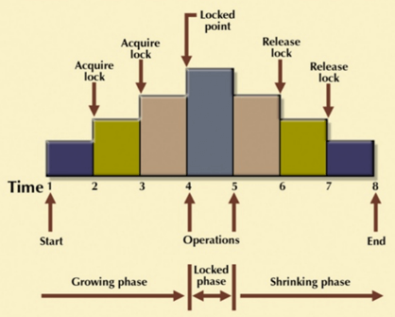
Two Phase Locking Protocol

Slide 24
Two Phase Locking Protocol
The Two-Phase Locking protocol allows each transaction to make a lock or unlock request in two steps:
Growing Phase: In this phase transaction may obtain locks but may not release any locks.
Shrinking Phase: In this phase, a transaction may release locks but not obtain any new lock
It is true that the 2PL protocol offers serializability. However, it does not ensure that deadlocks do not happen.

Slide 25
Two Phase Locking Protocol
 | T₁ | T₂
1 | lock-S(A)
2 |  | lock-S(A)
3 | lock-X(B)
4 | ……. | ……
5 | Unlock(A)
6 |  | Lock-X(C)
7 | Unlock(B)
8 |  | Unlock(A)
9 |  | Unlock(C)
10 | ……. | ……
Transaction T₁:
The growing Phase is from steps 1-3.
The shrinking Phase is from steps 5-7.
Lock Point at 3
Transaction T₂:
The growing Phase is from steps 2-6.
The shrinking Phase is from steps 8-9.
Lock Point at 6

Slide 26
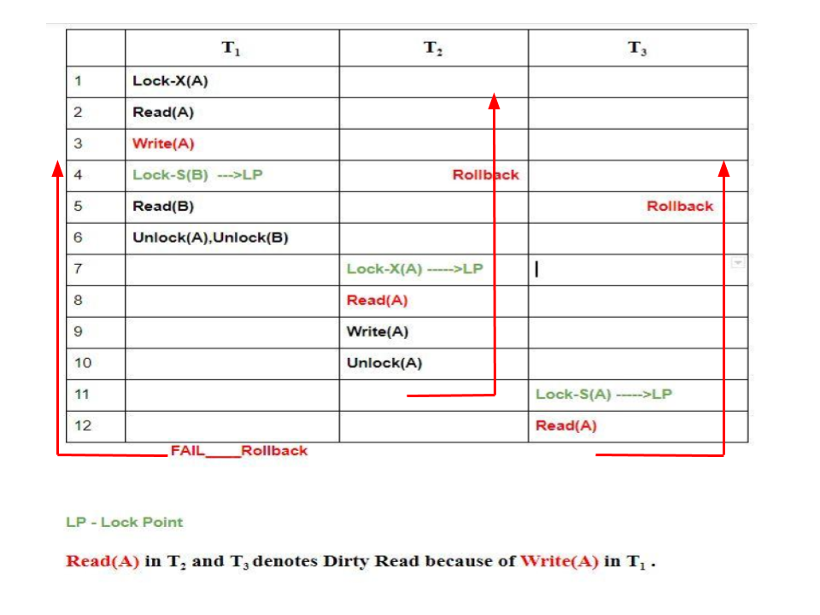
Two Phase Locking Protocol(Cascading Rollbacks in 2-PL
To analyze the schedule. because of Dirty Read in T₂ and T₃ in lines 8 and 12 respectively, when T₁ failed we have to roll back others also. Hence, Cascading Rollbacks are possible in 2-PL.

Slide 27
The Two-Phase Locking Protocol (Cont.)
Two-phase locking does not ensure freedom from deadlocks
Cascading roll-back is possible under two-phase locking. To avoid this, follow a modified protocol called strict two-phase locking. Here a transaction must hold all its exclusive locks till it commits/aborts. Recoverable and Cascadeless, but not free from Deadlock.
Rigorous two-phase locking is even stricter: here all locks are held till commit/abort. In this protocol transactions can be serialized in the order in which they commit. Recoverable and Cascadeless, but not free from Deadlock.

Slide 28
Conservative two-Phase Locking
also called as Static Two – Phase Locking Protocol. This protocol is almost free from deadlocks as all required items are listed in advanced. It requires locking of all data items to access before the transaction starts. It prevents deadlocks but not starvation and cascading rollbacks. However, it is difficult to use in practice because of the need to predeclare the read-set and the write-set which is not possible in many situations. In practice, the most popular variation of 2-PL is Strict 2-PL.
This protocol requires the transaction to lock all the items it access before the transaction begins execution by predeclaring its read-set and write-set. If any of the predeclared items needed cannot be locked, the transaction does not lock any of the items, instead, it waits until all the items are available for locking.

Slide 29
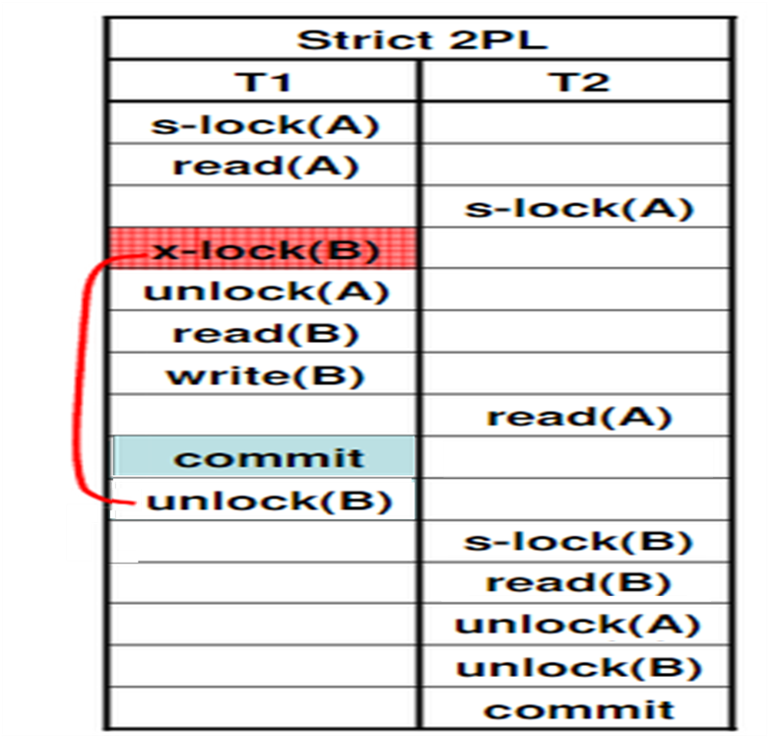
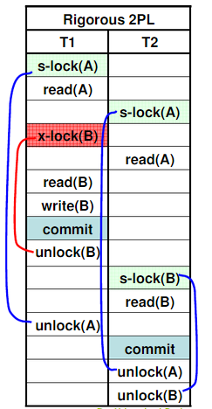

Slide 30
Strict 2-PL | Conservative 2-PL | Rigorous 2-PL
In Strict 2-PL, A transaction can acquire locks on data items whenever it requires (only in growing phase) during its execution. | A transaction has to acquire locks on all the data items it requires before the transaction begins it execution. | A transaction can acquire locks on data items whenever it requires (only in growing phase) during its execution.
It has growing phase. | It does not have a growing phase. | It has a growing phase.
It has partial shrinking phase. | It has a shrinking phase. | It does not have a shrinking phase.
It ensures that the schedule generated would be Serializable, Recoverable and Cascadeless. | It ensures that the schedule generated would be Serializable and Deadlock-Free. | It ensures that the schedule generated would be Serializable, Recoverable and Cascadeless.
It does not ensures Deadlock-Free schedule. | It does not ensures Recoverable and Cascadeless schedule. | It does not ensures Deadlock-Free schedule.
It ensures that the schedule generated would be Strict. | It does not ensure Strict Schedule. | It ensures that the schedule generated would be Strict.

Slide 31
Thank You

